Slide 1
Hash Tables

Slide 2
Hash Table & Dictionaries
Recall that dictionary has
Data of any type
Operations: insert, search and delete
Trees and skip lists implement dictionaries
Overhead of Θ(log n) in the worst and average cases
Achieve more than dictionary due to ordered elements
E.g. minimum and next
Hash table
Implements dictionary

Slide 3
Hash Tables
Data
Input domain is (key, value) pair, keys in universe U
We begin by assuming that U is integers
Elements of hash table
Array A of size m<<|U|
Hash function h:U→{0,…,m-1}
Operations (ideal setting)
Insert(k,x) – A[h(k)]←(k,x)
Search(k) – retrieve A[h(x)]
Delete(k) – delete contents of A[h(x)]

Slide 4
Collisions
Ideal solution breaks
|U|>m ➔∃x≠y h(x)=h(y)
Insert(x) followed by insert(y) causes a collision
Collisions in hash tables are inevitable
Solutions
Chained hashing
Open addressing

Slide 5
Chained Hashing
A[i] is header of linked list
Holds every k s.t. h(k)=i
Insert(k,x)
Linked list insert (into beginning of list in A[h(k)])
Time – O(1)
Search(k)
Linked list search in A[h(k)]
Time – length of list in A[h(k)]
Delete(k) – linked list search and then delete

Slide 6
Worst Case vs. “Normal” Case
Worst case input
Hash table degenerates to linked list
Bad choice of hash function
Example – web server stores incoming packets by destination IP and address
Adversary controls input
Simple Uniform Hash Assumption
Hash function distributes input uniformly into array
Practical assumption when
Function h is independent of input
No adversary expected

Slide 7
Load Factor and O(1) time
Number of elements – n
Load factor is α=n/m
Under Simple Uniform Hash
Probability that k is mapped to A[i] is 1/m
Expected number of elements in A[i] is α
Expected time of search Θ(1+α)
Unsuccessful search accesses α elements on average
Successful search accesses α/2 elements on average
m=O(n) ➔ all operations are expected O(1) time

Slide 8
Open Addressing
All data in array
Search has two parts
Hash key to array entry
If full follow probe sequence to next addresses
Hash function h:U×{0,…,m-1}→{0,…,m-1}
Second input – probe count
Popular probe sequences
Linear probing
Quadratic probing
Double hashing

Slide 9
Pros and Cons of Open Addressing
Advantages
Less space
Potentially more cache friendly
Faster
Challenges
Deletion in middle of search sequence causes failed search for existing values
Search speed depends on load balance non-linearly
Load balance has to be kept below a threshold
Clustering

Slide 10
Deletion
Two “marks” for vacant entry
Empty
Deleted
Table is initialized to “empty”
After deletion, entry marked by “deleted”
A search path stops at empty but continues at deleted
Lazy deletion
In each successful search swap entry with first deleted entry in path
Mark previous entry by deleted

Slide 11
Rehashing
Insert all data items into new hash table
Typically with new hash function
Useful when
Load factor is high
Table size is usually doubled (roughly)
Number of deleted (not empty) items is high
Table size may remain the same
Complexity O(m+n) assuming uniform hashing
Amortized complexity – O(1)
Again with uniform hashing

Slide 12
Linear probing
Hash function h(k,i)=h’(k)+i
Sequence wraps around array
Generalization to step by c slots
Rarely used
Cache friendly
Tends to cause clustering
The probability of a cluster of length k to grow to k+1 is k/m

Slide 13
Quadratic Probing
Hash function h(k,i)=h’(k)+ai+bi² mod m
For constants a, b
Clustering behavior better than linear probing
Locality worse than linear probing
Challenge
h(k,0), h(k,1), h(k,2),… may not be a permutation of (0,…,m-1)
If m is prime repeated values after (m+1)/2 steps
If m is not prime values repeat much faster
h(k,i)=h’(k)+(-1)^{i}i² mod m generates a permutation of (0,…,m-1) for prime m≡3 mod 4
Examples

Slide 14
Double Hashing I
Hash function h(x,i)=h₁(x)+ih₂(x) mod m
Two hash functions h₁,h₂:U→{0,…,m-1}
In practice close to ideal hash function
Clustering behavior better than linear and quadratic probing
Locality worse than both
Number of probed elements in h(x,0),h(x,1),…
If GCD(m,h₂(x))=d then maximum number of elements in probe is m/d
Permutation of (0,…,m-1) if and only if GCD(m,h₂(x))=1

Slide 15
Double Hashing II
Typical choice:
m is a prime number
h₂ maps elements to {0,…,m’} for m’<m-1

Slide 16
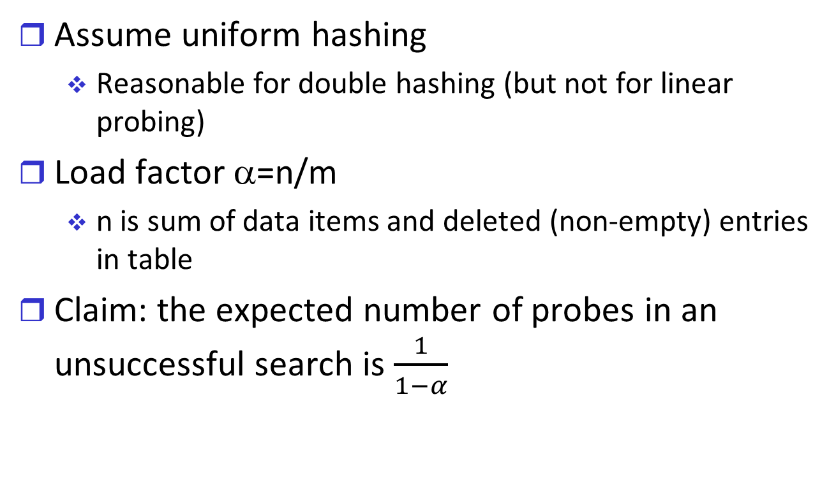
Performance of Open Addressing
Assume uniform hashing
Reasonable for double hashing (but not for linear probing)
Load factor α=n/m
n is sum of data items and deleted (non-empty) entries in table
Claim: the expected number of probes in an unsuccessful search is $\frac{1}{1−α}$

Slide 17
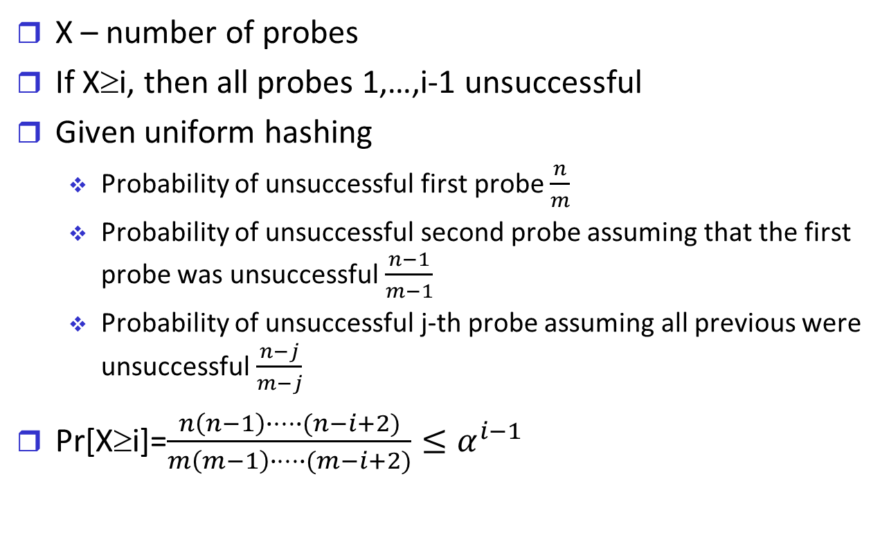
Unsuccessful Search – Proof I
X – number of probes
If X≥i, then all probes 1,…,i-1 unsuccessful
Given uniform hashing
Probability of unsuccessful first probe $\frac{n}{m}$
Probability of unsuccessful second probe assuming that the first probe was unsuccessful $\frac{n−1}{m−1}$
Probability of unsuccessful j-th probe assuming all previous were unsuccessful $\frac{n−j}{m−j}$
Pr[X≥i]=$\frac{n\left(n−1\right)∙…∙(n−i+2)}{m\left(m−1\right)∙…∙(m−i+2)}≤α^{i−1}$

Slide 18
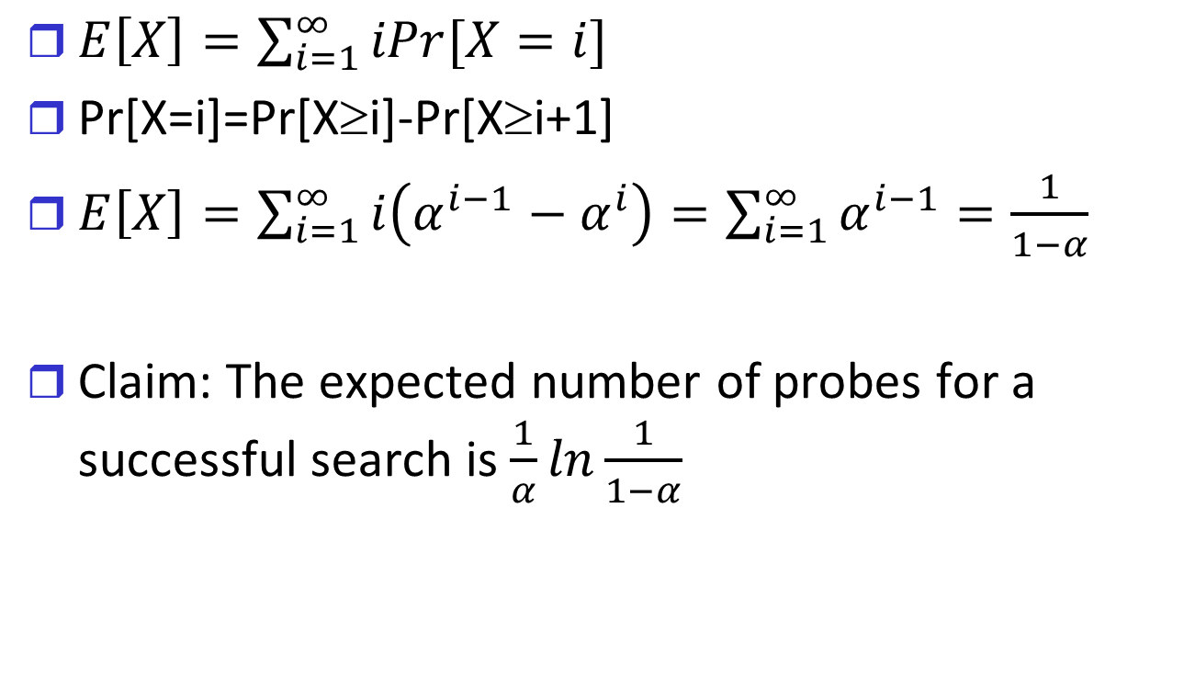
Unsuccessful Search – Proof II
$E\left[X\right]=\sum_{i=1}^{∞}{iPr[X=i]}$
Pr[X=i]=Pr[X≥i]-Pr[X≥i+1]
$E\left[X\right]=\sum_{i=1}^{∞}{i\left(α^{i−1}−α^{i}\right)=\sum_{i=1}^{∞}{α^{i−1}=\frac{1}{1−α}}}$
Claim: The expected number of probes for a successful search is $\frac{1}{α}ln\frac{1}{1−α}$

Slide 19
Universal Hashing I
Any single hash function may be bad for specific input
Think adversarial behavior
Consider family H
h:U→{0,…,m-1} for all h∈H
Choose random h∈H at
Initialization of hash table
Each rehashing

Slide 20
Universal Hashing II
H is a universal family of hash functions [Carter, Wegman 1977] if for every two different keys k,k’
|{h∈H| h(k)=h(k’)}|≤|H|/m
Probability of k and k’ colliding is identical to probability of inserting them randomly into table
Claim: in chained hashing with universal hashing the expected length of a search is O(α)
Proof: let X_{k,k’} be an indicator for a collision
X_{k,k’}=1 if h(k)=h(k’) and is zero otherwise
E(X_{k,k’})=1/m by definition

Slide 21

Universal Hashing III
The length of a search is exactly the number of elements mapped to h(k)
Expected number (linearity of expectation)
$\sum_{i}{\frac{1}{m}=α}$

Slide 22
Choosing a Universal Family I
Claim: if p is a prime then for any x≠0 mod p there is x⁻¹ such that xx⁻¹≡1 mod p
Universal hash family for integers
Choose prime p>m
Define h_{a,b}(x)=(ax+b mod p) mod m
H={h_{a,b} | a∈{1,…,p-1}, b∈{0,…,p-1}}
h_{a,b}(x)=h_{a,b}(y)
(ax+b mod p)≡(ay+b mod p) mod m
ax+b mod p = ay+b mod p +im 0≤i≤(p-1)/m
a=im(x-y)⁻¹ mod p

Slide 23

Choosing a Universal Family II
There are (p-1)/m values for i
There are p-1 values for a
Probability of collision $\frac{(p−1)/m}{p−1}=\frac{1}{m}$

Slide 24
Tabulation Hashing
A hashing idea for strings over alphabet Σ
Assume the strings are of length k
Let T be a k×Σ matrix with random values in {0,…,m-1}
Define h_{T}:Σ^{k}→{0,…,m-1} by
h(s₁,…,s_{k})=T(1,s₁)+….+T(s_{k}) mod m
Easy extension to (universal) family by considering H={h_{T}| any k×Σ matrix T}

